Slide 1

Gun Violence in the U.S.
Team Koneni: Amey Athaley, Khyathi Balusu , Rawini Dias, Sadhana Koneni, Satya Pachigolla

Slide 2
Outline
Introduction
Understanding the Data
Analysis
Time Series Trends
Trends by State
Trends by Incident type
Gun Ownership per Capita
Gun Laws
Mental Illness
Insights

Slide 3
Introduction
Gun Violence statistics in the United States are truly alarming
The debate on gun violence and gun control has implications on our human right to life
Our analysis explores:
Trends by time and location
Trends by the number of gun laws
Trends by the number of guns owned per capita
Trends between gun violence and mental illness
We hope this analysis will provide useful information for those who propose regulations and legislation relating to gun usage

Slide 4


Understanding the Data
Dataset:
Gun violence dataset from Kaggle
29 columns x 300,000 rows
US Census bureau data
Gun laws and gun ownership data
Health Searches by US Metropolitan area

Slide 5
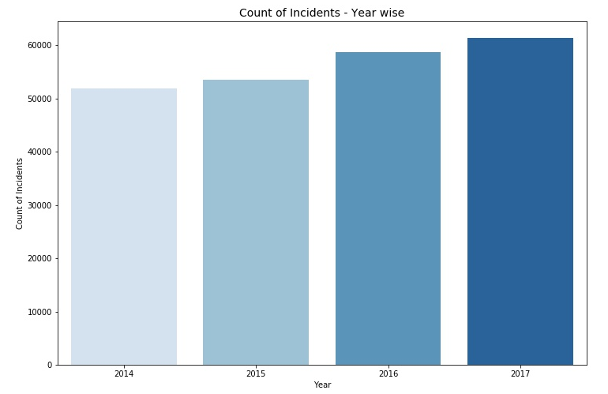
Incident Count - Year wise
Data for 2013 & 2018 has been excluded, for being incomplete
2014 - 2017 shows a steady increase
Notes:
Here incident count is the number of injuries and deaths together. Incident is any incident that involved assault/harm with a gun.

Slide 6
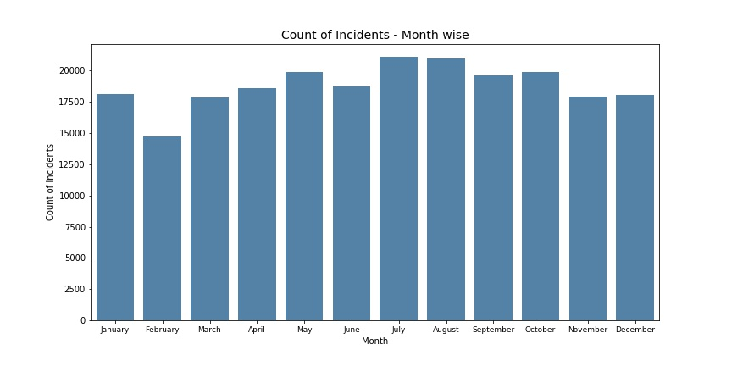
Incident Count - Month wise
Notes:
Can talk about why July and August have higher count

Slide 7
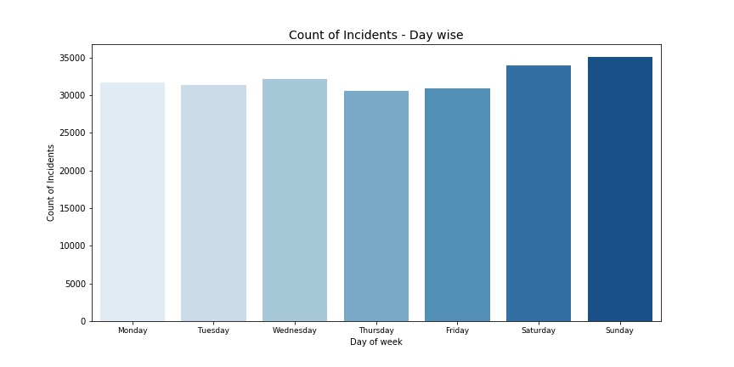
Incident Count - Day wise
Notes:
Quite naturally, weekends will be having more incident counts

Slide 8
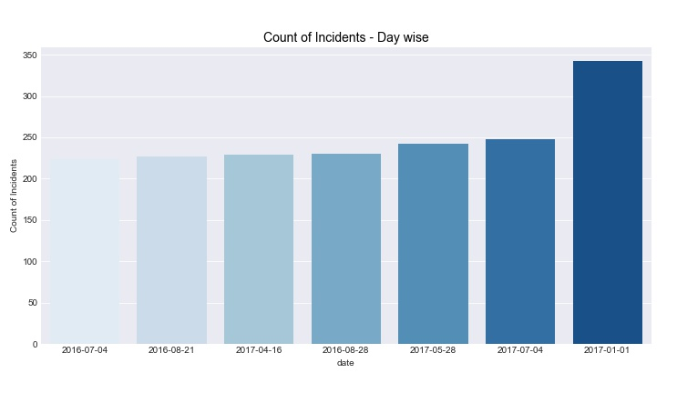
Incident Count - a few unfortunate days
Notes:
https://www.vox.com/2017/1/5/14168440/2017-new-year-gun-violence-deaths
https://www.usatoday.com/story/news/nation/2017/07/05/july-4th-weekend-shootings-chicago/452585001/

Slide 9
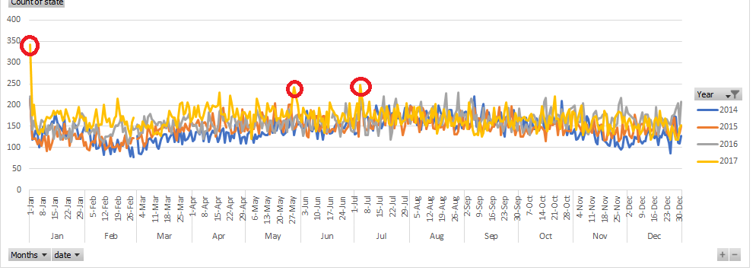
Incident Count - an overview of unfortunate days

Slide 10
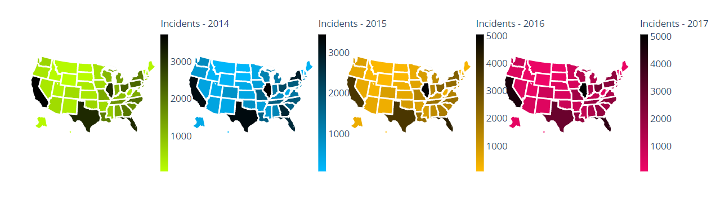
Total Incidents by State

Slide 11
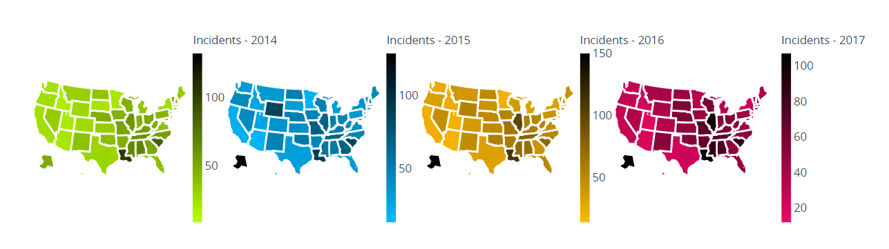
Per capita Incidents by State*
Notes:
District of Columbia is removed from all years as the numbers are too high and it is skewing the scale by a lot
Can talk about how Alaska had less incidents in 2014 but increased later
http://www.newsminer.com/news/local_news/alaska-s-stand-your-ground-law-to-go-into-effect/article_b38db37e-f75b-11e2-8575-001a4bcf6878.html - Stand your ground state since 2013. Took some time to see it’s implications

Slide 12
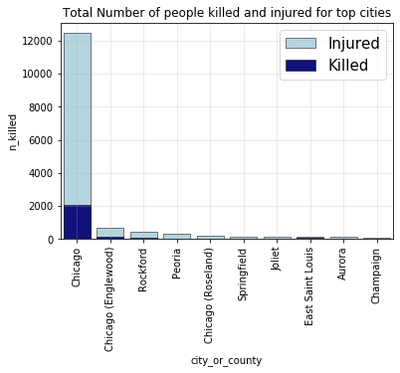
Illinois
4173
81
Total Incidents
Incidents per Million
Year | Rank by #Incidents | Rank - # Incidents per Mil
2014 | 4 | 9
2015 | 1 | 9
2016 | 1 | 4
2017 | 1 | 5

Slide 13
Illinois
Illinois has the highest number of incidents across US for 3 years straight
They have a high number of Gang Related incidents and Armed Robberies
In Illinois, the capital city Chicago has the highest number of gun violence victims
Chicago is the city with the highest number of ‘Gang Related’ incidents for all 4 years

Slide 14
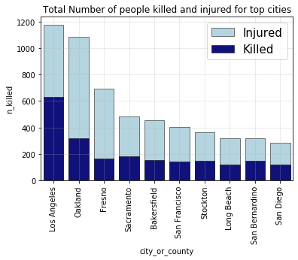
California
3792
24
Total Incidents
Incidents per Million
Year | Rank by #Incidents | Rank - # Incidents per Mil
2014 | 1 | 44
2015 | 3 | 48
2016 | 3 | 46
2017 | 2 | 44

Slide 15
California
In terms of incidents California is in the top 3 for all years
But the per capita rank suggests that the in California the high incident numbers is because of its dense population
In California, Los Angeles has the highest number of gun violence victims
Los Angeles is in the top 5 cities with ‘Gang Related’ incidents for all 4 years

Slide 16
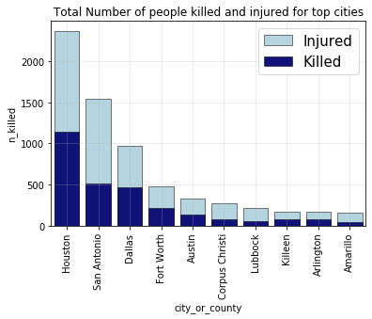
Texas
3222
29
Total Incidents
Incidents per Million
Year | Rank by #Incidents | Rank - # Incidents per Mil
2014 | 3 | 39
2015 | 2 | 45
2016 | 4 | 43
2017 | 4 | 47

Slide 17
Texas
Texas is consistently present in the Top 5 list for number of incidents. But when we look at incidents per capita, Texas comes down the list
Most incidents in Texas are Armed Robberies
Within Texas, Houston has the highest number of victims and Austin stands fifth
Within all cities of US, Houston ranks 1st with highest number of Defensive Use incidents for all 4 years

Slide 18
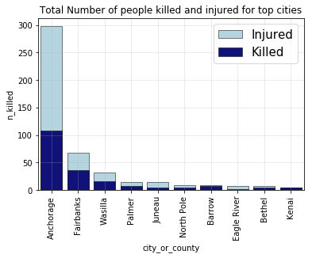
Alaska
322
108
Total Incidents
Incidents per Million
Year | Rank by #Incidents | Rank - # Incidents per Mil
2014 | 45 | 16
2015 | 37 | 2
2016 | 36 | 2
2017 | 40 | 2

Slide 19
Alaska
Alaska has a lower number of incidents but when looked at numbers per capita, Alaska stands second for 3 years straight. The 1st being District of Columbia
Alaska’s biggest city Anchorage has the highest number of gun violence victims
Between 2014 and 2015, we saw a spike in the number of Drug Related Incidents and Defensive Use incidents

Slide 20
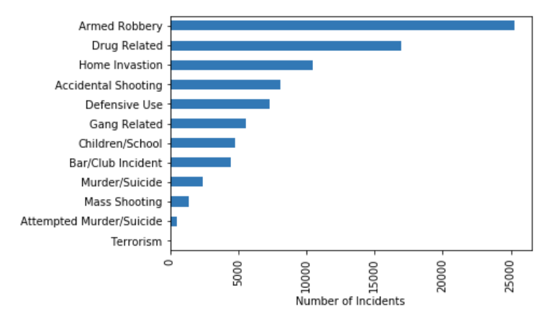
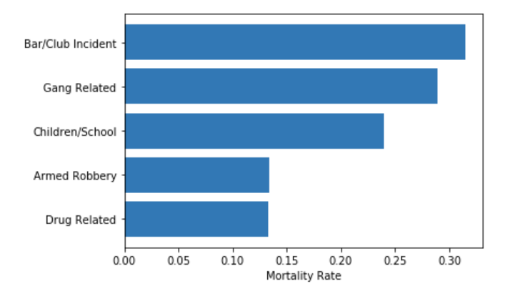
Analysis by Incident Type

Slide 21
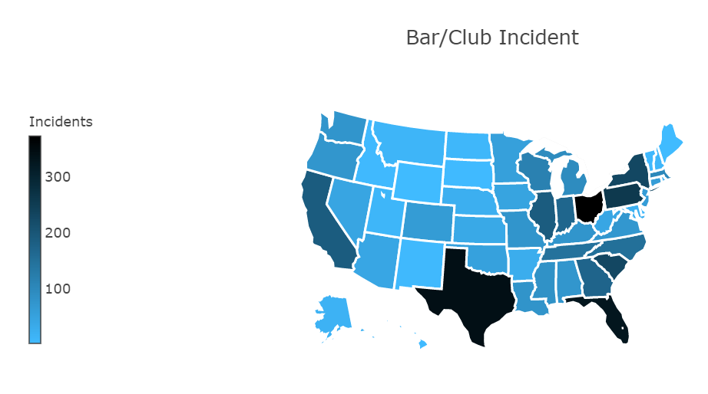
Bar/Club Incidents
Rank | State | Number of Incidents
1 | Ohio | 372
2 | Texas | 342
3 | Florida | 328
4 | Pennsylvania | 259
5 | South Carolina | 232
On average, Bar/Club incidents have higher number of people killed per incident
Cleveland & Columbus(Ohio), Houston(Texas),Philadelphia(Pennsylvania) have the highest number of incidents at the city or county level

Slide 22
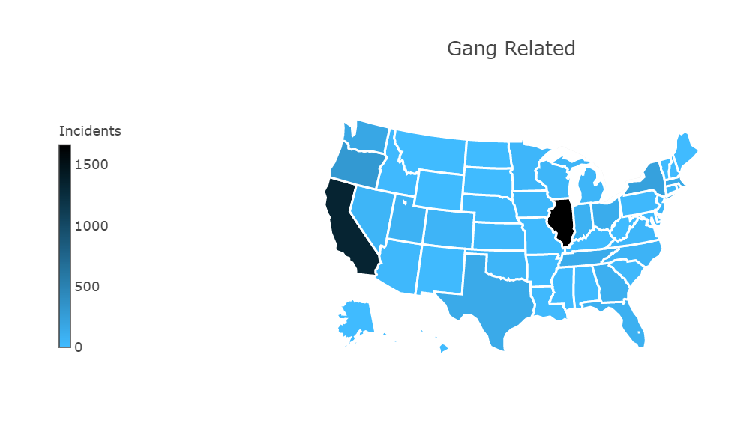
Gang Related Incidents
Rank | State | Number of Incidents
1 | Illinois | 1663
2 | California | 1339
3 | Oregon | 301
4 | New York | 229
5 | Washington | 177
Illinois and California stand out with a very high incidence of gun violence among the states
Many state legislatures have enacted laws, like California’s law on Gang Affiliation Enhancement, that are designed to discourage gang affiliation.
According to the STEP Act (“California Street Terrorism Enforcement and Prevention Act”), a defendant can receive an additional sentence if they are affiliated with a gang or helped one.

Slide 23
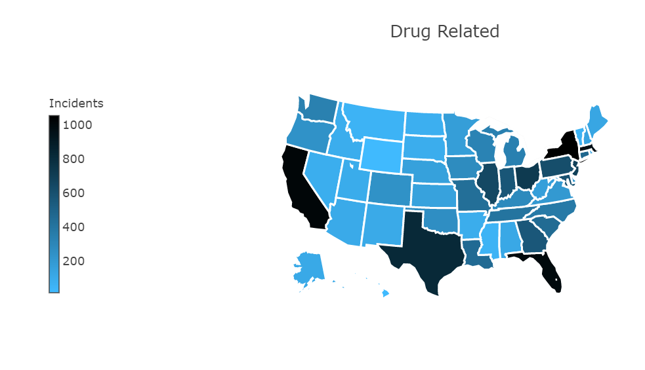
Drug Related Incidents
Rank | State | Number of Incidents
1 | New York | 1056
2 | California | 1023
3 | Florida | 1002
4 | Massachusetts | 975
5 | Texas | 828
Incidents associated with drug trade/use
According to the Department of Justice’s National Gang Center, particularly in urban areas, significant percentages of gun-related homicides (15 percent to 33 percent) are linked with gang and drug activity
Top 5 cities or counties for these incidents are Baltimore, Boston, Springfield, Hartford and Indianapolis are in the North Eastern region of the US
Notes:
https://www.nationalgangcenter.gov/survey-analysis/measuring-the-extent-of-gang-problems
https://www.cdc.gov/mmwr/preview/mmwrhtml/mm6103a2.htm

Slide 24
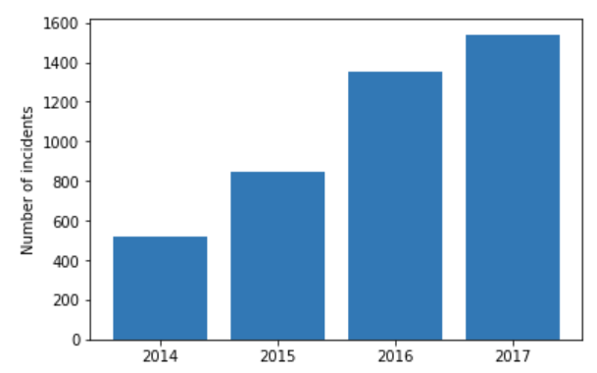
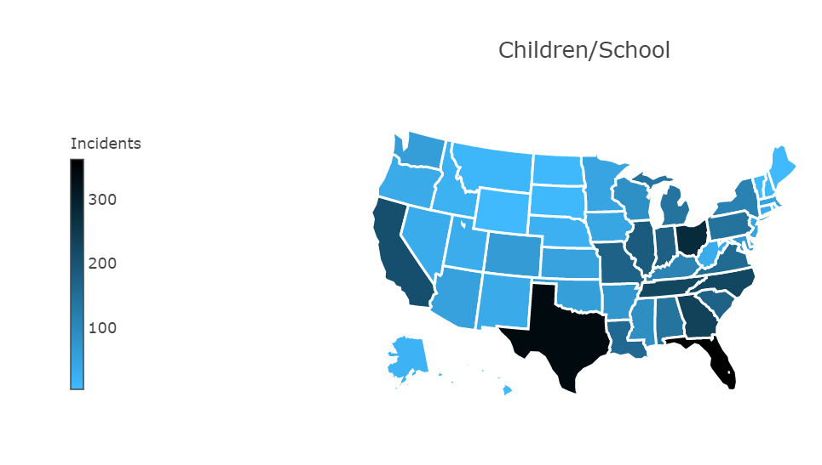
Children/School Incidents
Rank | State | Number of Incidents
1 | Florida | 362
2 | Texas | 342
3 | Ohio | 279
4 | Georgia | 235
5 | Tennessee | 228
4.6 million minors in the US live in homes with at least one loaded, unlocked firearm ¹
Twenty-seven states excluding Ohio have enacted child access prevention laws
Notes:
Deborah Azrael, Joanna Cohen, Carmel Salhi, and Matthew Miller, “Firearm Storage in Gun–owning Households with Children: Results of a 2015 National Survey,” Journal of Urban Health 95, no. 3 (2018): 295–304

Slide 25
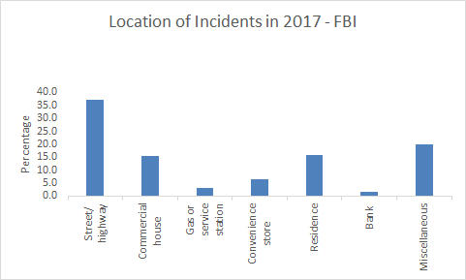
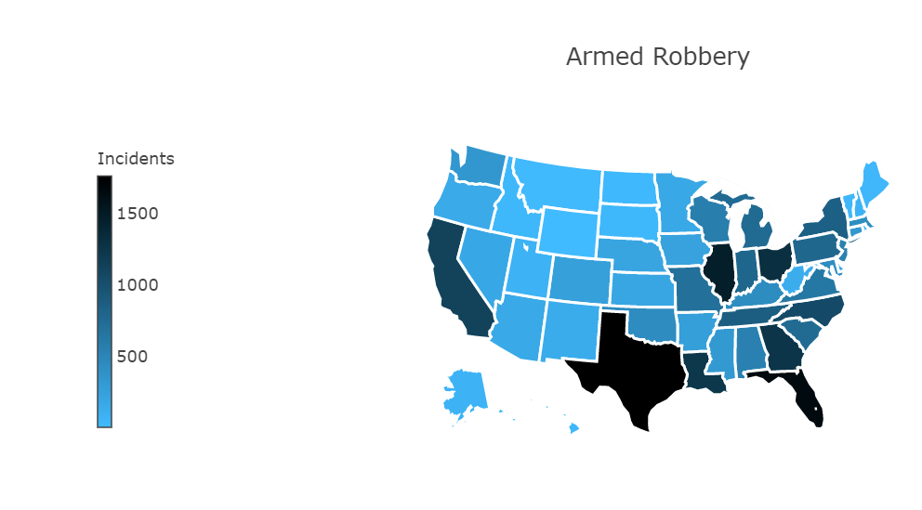
Armed Robbery Incidents
Rank | State | Number of Incidents
1 | Texas | 1760
2 | Florida | 1666
3 | Illinois | 1468
4 | Ohio | 1318
5 | Georgia | 1259
Armed Robbery has the highest number of incidents among the categories
New Orleans, Chicago, Washington and Houston are the top 4 cities for armed robbery incidents

Slide 26
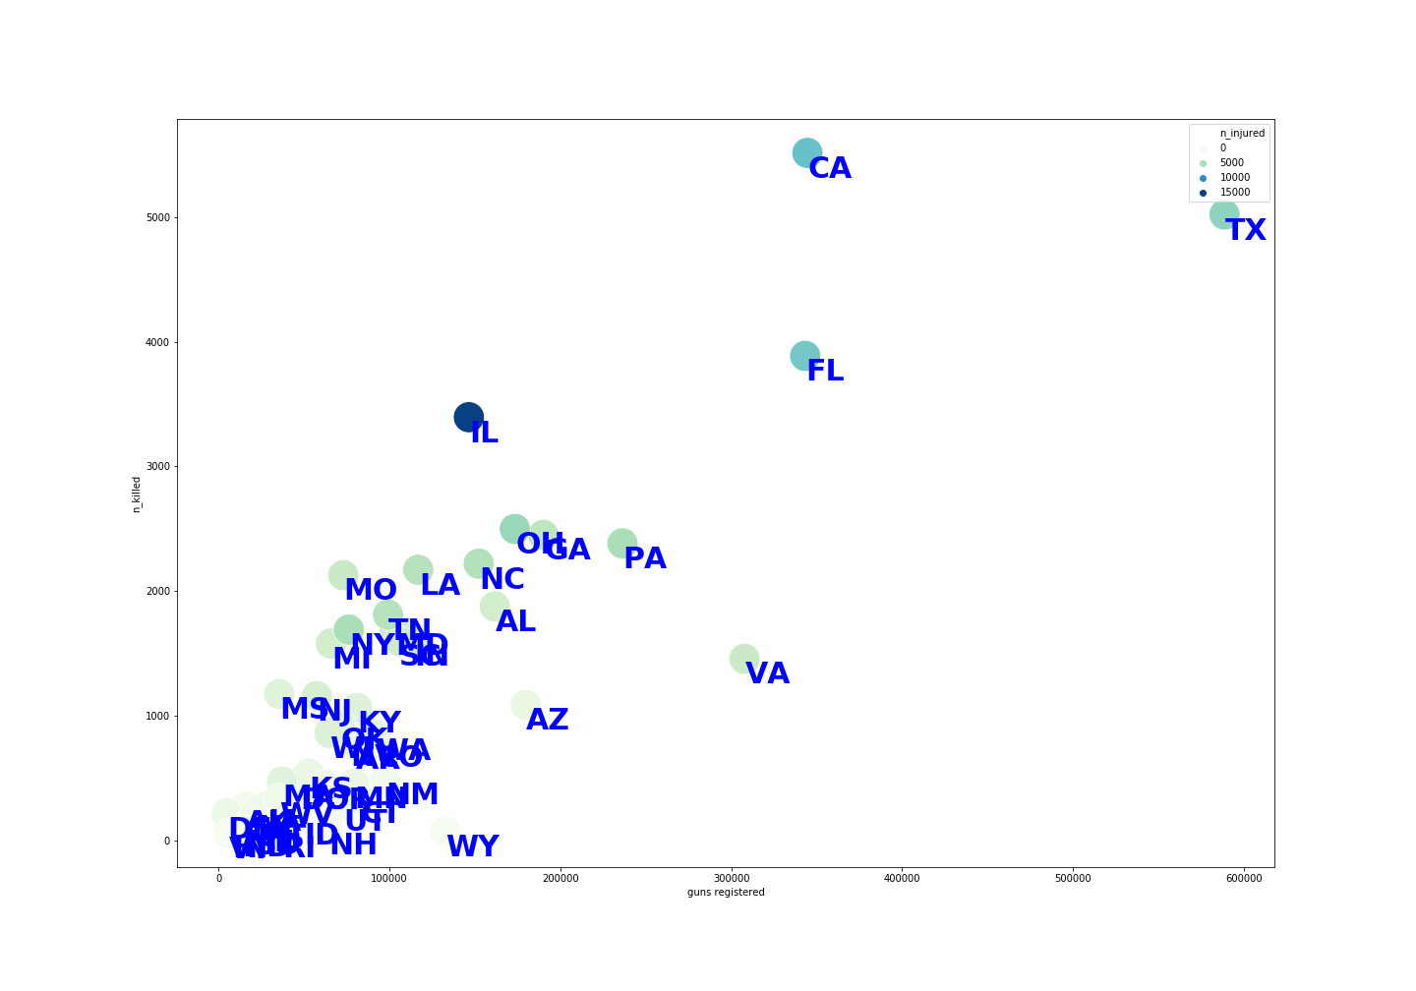
Higher gun ownership exhibits higher gun deaths
Rank | State | Number of guns
1 | Texas | 588k
2 | California | 344k
3 | Florida | 343k
4 | Virginia | 307k
5 | Pennsylvania | 236k

Slide 27
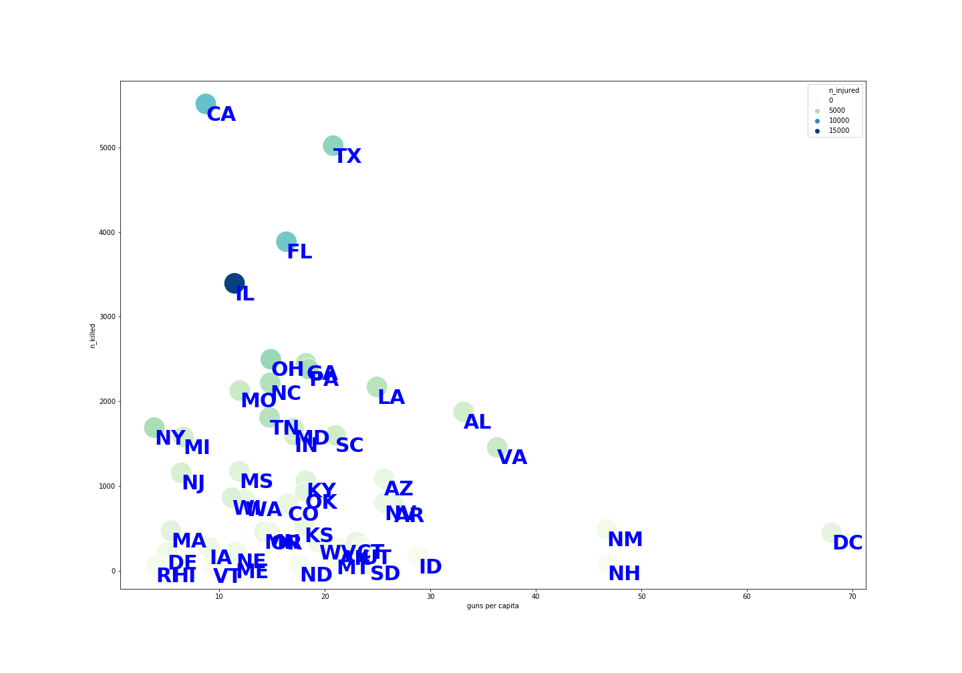
Guns Ownership per 1000 capita
Rank | State | Number of guns/ 1000 capita
1 | Wyoming | 588
2 | DC | 68
3 | New Hampshire | 47
4 | New Mexico | 47
5 | Virginia | 36

Slide 28

More laws translate to lower incidents
Law Categories | Correlation with gun crimes
Ammunition Regulations | -0.96
Buyer regulations | -0.93
Dealer regulations | -0.95
Possession regulations | -0.96
Stand your ground | +0.71
At an aggregated yearly level, total no of laws and no of people harmed by gun violence were negatively correlated at -0.798

Slide 29
Which laws are the most impactful?
Law Categories | Correlation with gun crimes
Ammunition Regulations | Licensing, Background Checks
Buyer Regulations | Permission, Training, Restrictions, Theft
Dealer Regulations | Licensing, reporting & junk guns
Possession regulations | Age restrictions, Carrying restrictions
Stand your ground | Right to defend even to the point of application of lethal force

Slide 30
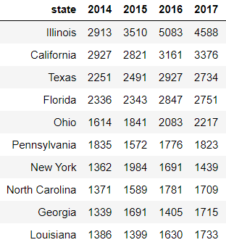
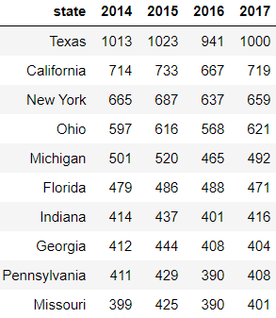
Gun Violence & Mental Illness
Top 10 States with Gun Violence
Top 10 States with High Depression Numbers

Slide 31
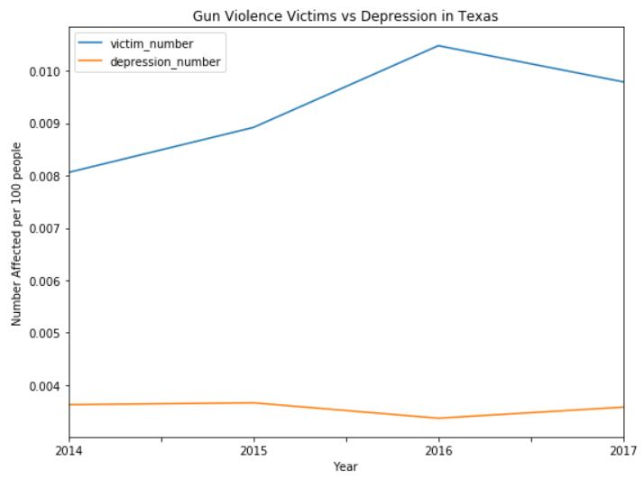
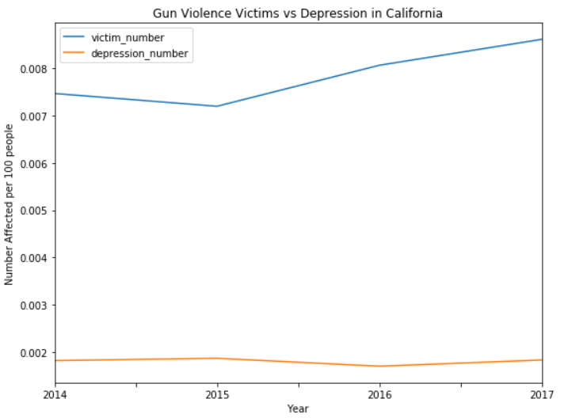
Comparison of Gun Violence & Mental Illness Numbers by State
Texas
California

Slide 32
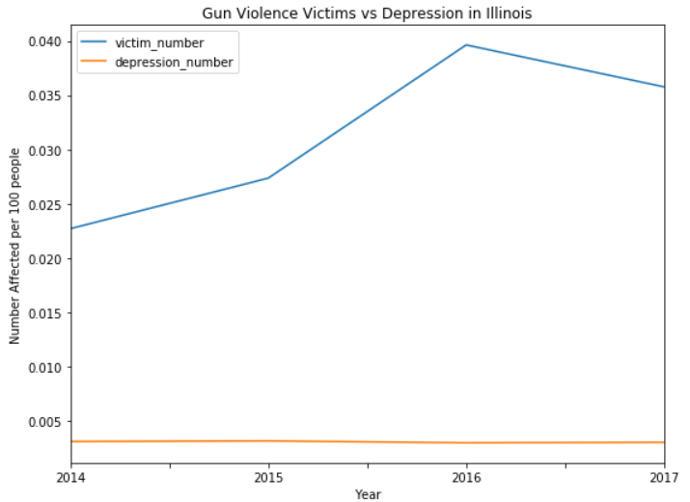
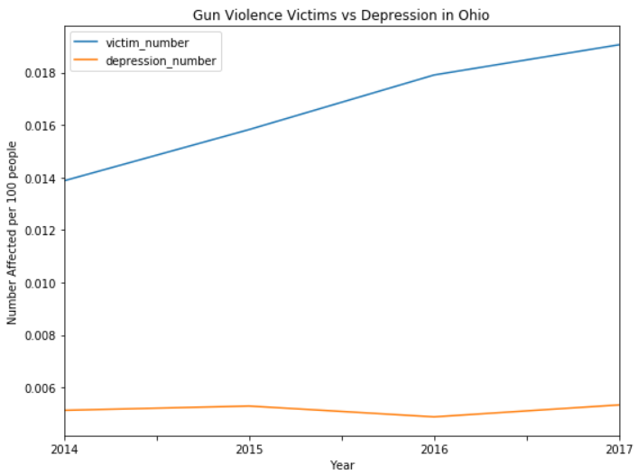
Comparison of Gun Violence & Mental Illness Numbers by State
Illinois
Ohio

Slide 33
Insights
Based on the analysis by state, Anchorage, Alaska has a large number of gun violence incidents per million people despite being sparsely populated
Despite the laws against gang related activities, California and Illinois have very high incidence of gang related gun violence
Laws that aim to regulate gun possession, ownership, and usage are most effective in curbing gun violence while ‘stand your ground’ law is observed to increase incidents
More gun ownership per 1000 capita does not necessarily lead to high incidents
Based on the analysis of mental illness by state, there is no evidence of correlation between gun violence and mental illness

Slide 34
Questions?

Slide 35
References
Gun Laws in US : http://www.statefirearmlaws.org/
Gun ownership by state in US : https://www.thoughtco.com/gun-owners-percentage-of-state-populations-3325153

Slide 36
Appendix

Slide 37
Time Series Trends
Analysis done:
Year wise
Month wise
Day of Week wise
A few days with high incident count
Insights gained:
Highest in year 2017
Highest in July
Highest on Weekends (Sunday)
Highest on July 4 (two years’ July 4)

Slide 38
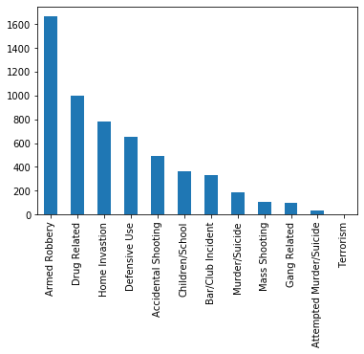
Florida
3549
43
Total Incidents
Incidents per Million
Year | Rank by #Incidents | Rank - # Incidents per Mil
2014 | 2 | 29
2015 | 5 | 40
2016 | 2 | 24
2017 | 3 | 26

Slide 39
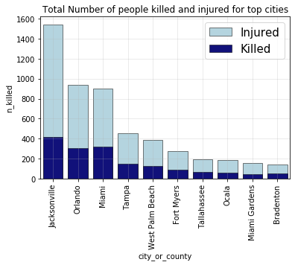
Florida
Florida is consistently present in the Top 5 list for number of incidents
‘Armed Robberies’ are more predominant that any other type of incidents
Jacksonville has the highest number of gun violence victims. This number is almost twice the victims in second highest city Orlando

